Slide 1



pbi
View in Power BI
Last data refresh:
17/05/2024 12:00:09 UTC
Downloaded at:
17/05/2024 12:01:12 UTC

Slide 2
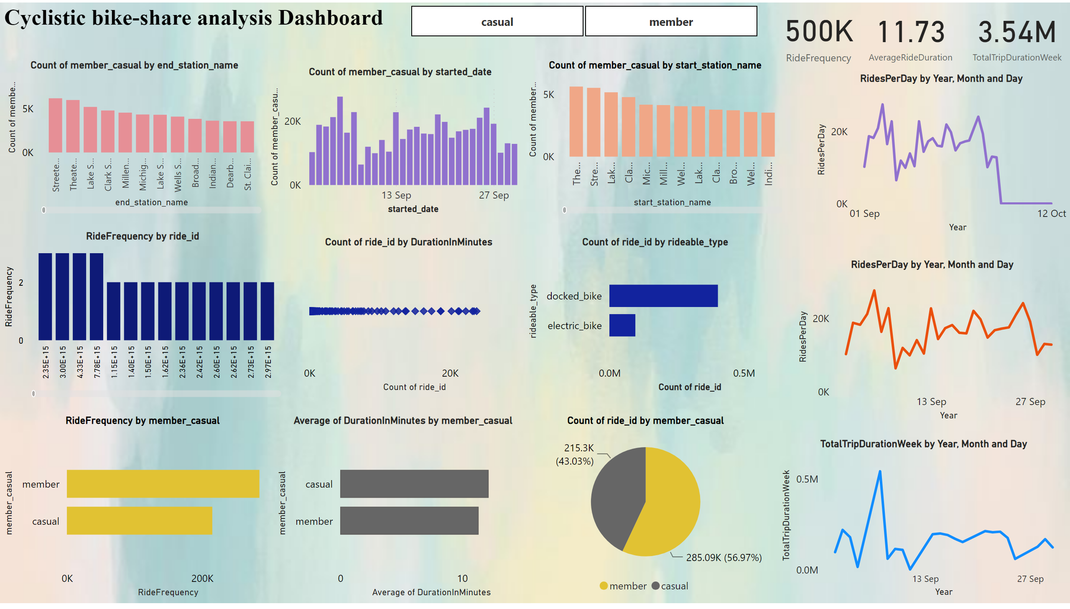
DASHBOARD
Notes:
textbox
No alt text provided
lineChart
No alt text provided
lineChart
No alt text provided
lineChart
No alt text provided
card
No alt text provided
card
No alt text provided
columnChart
No alt text provided
columnChart
No alt text provided
columnChart
No alt text provided
pieChart
No alt text provided
barChart
No alt text provided
barChart
No alt text provided
clusteredColumnChart
No alt text provided
scatterChart
No alt text provided
barChart
No alt text provided
slicer
No alt text provided
card
No alt text provided

Slide 3
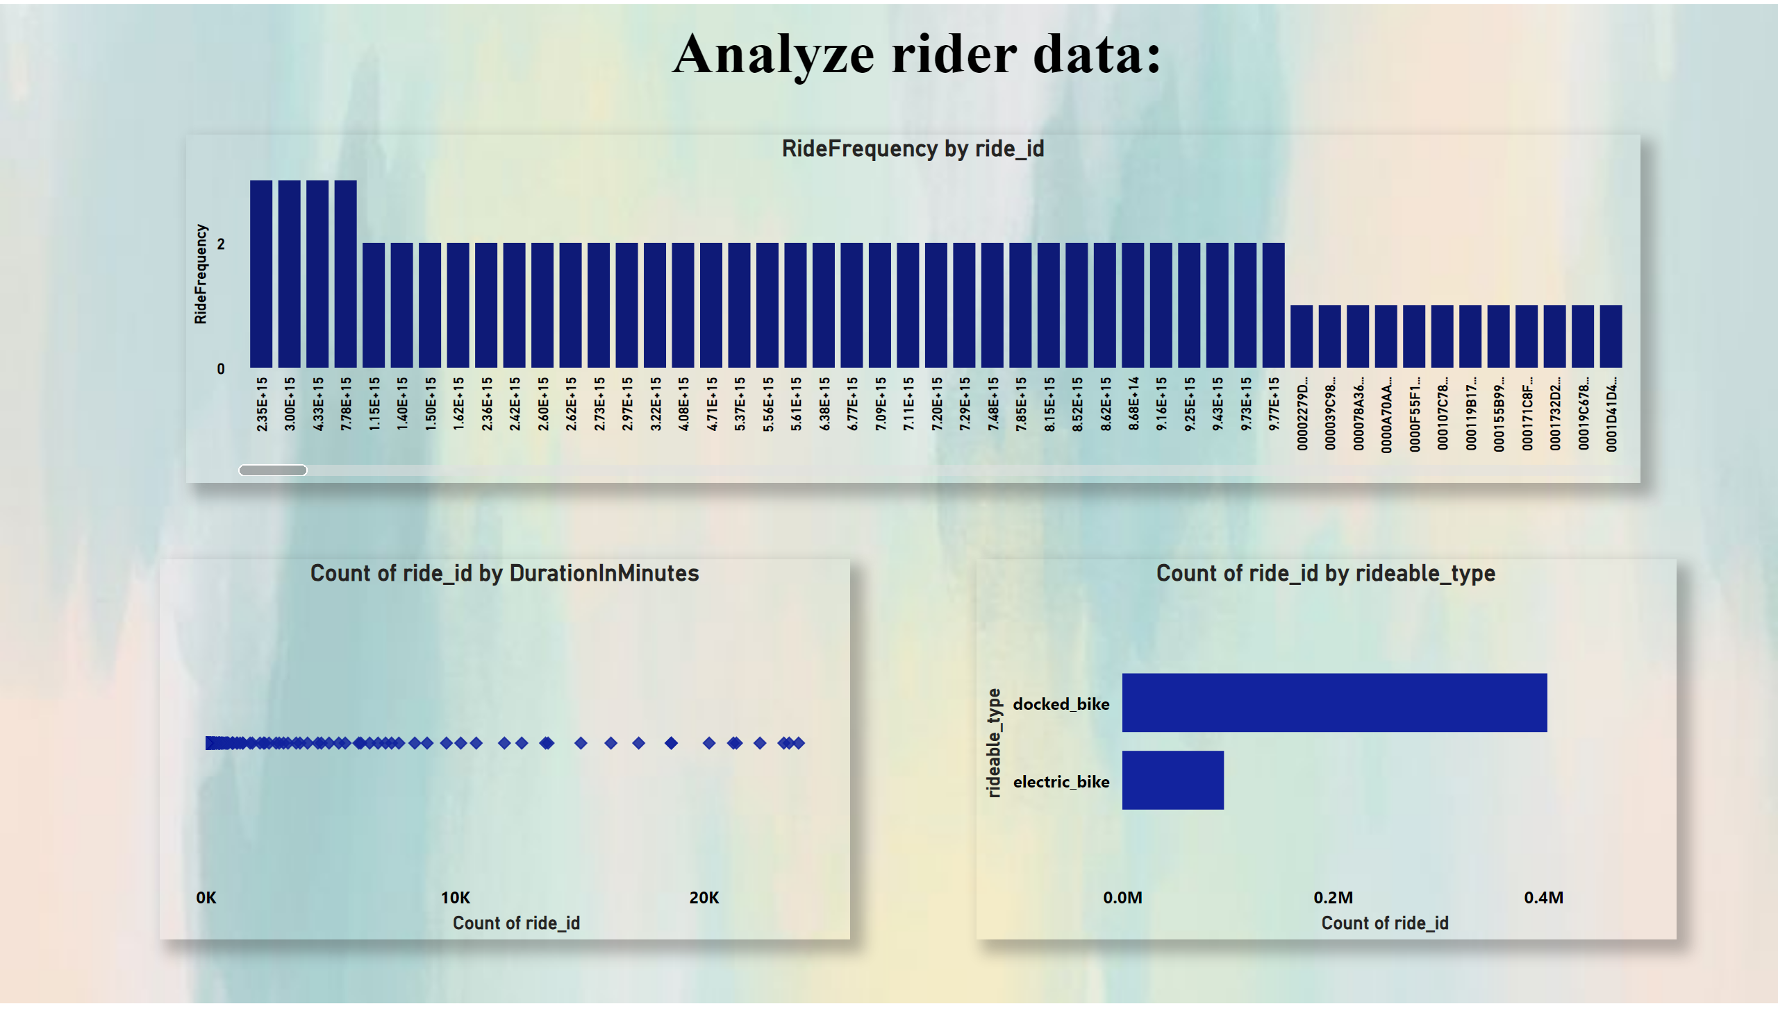
analyse rider
Notes:
clusteredColumnChart
No alt text provided
textbox
No alt text provided
scatterChart
No alt text provided
barChart
No alt text provided

Slide 4
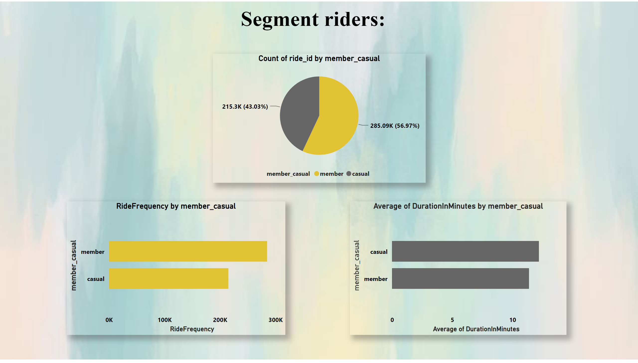
Segment riders
Notes:
textbox
No alt text provided
pieChart
No alt text provided
barChart
No alt text provided
barChart
No alt text provided

Slide 5
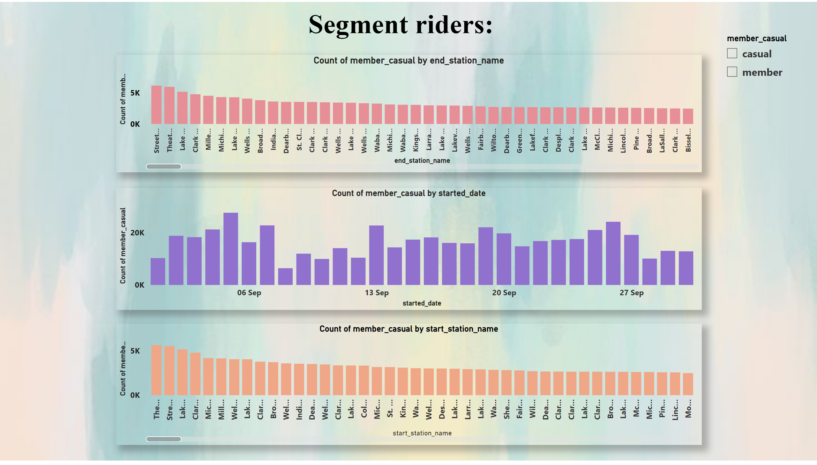
Segment riders
Notes:
textbox
No alt text provided
columnChart
No alt text provided
columnChart
No alt text provided
columnChart
No alt text provided
slicer
No alt text provided

Slide 6
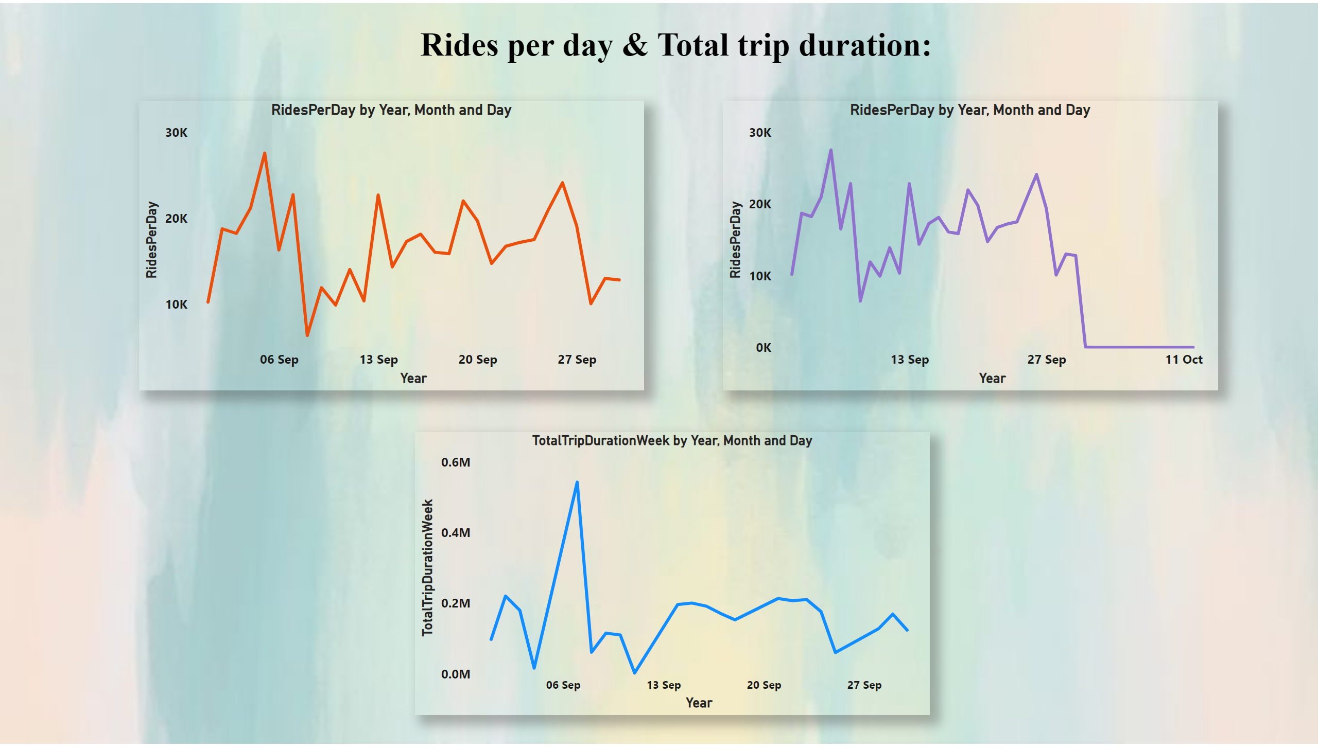
Rides per day & Total trip duration
Notes:
textbox
No alt text provided
lineChart
No alt text provided
lineChart
No alt text provided
lineChart
No alt text provided

